Slide 1
Software Development Models

Slide 2
Terminology
Software Process defines the way to produce software. It includes
Software life-cycle model
Tools to use
Individuals building software
Software life-cycle model defines how different phases of the life cycle are managed.
Software Development Life Cycle (SDLC)

Slide 3
Phases of Software Development
These phases can be crunched in time – overlapped, etc… and this is one of the big challenges of software development in general.

Slide 4
Life-Cycle Models
Build-and-fix model
Waterfall model
Rapid prototyping model
Spiral model
Prototyping Model
Phased Development Model
incremental development model
iterative development model
Formal Systems Development
Agile models (model or method)
Extreme programming
Scrum
FDD
See – Ian Sommerville, Software Engineering, 5 to 9 editions for good chapter on process models

Slide 5
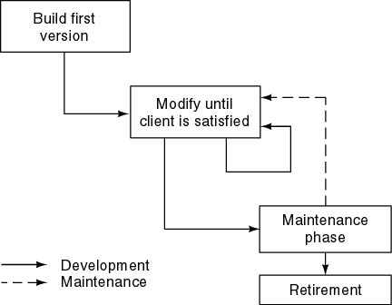
Build and Fix Model
Lots of software is developed using build-and-fix model (e.g. student projects)
Basically there is no model.
No specifications
No design
This model is unsatisfactory and should not be adopted.
Why?
Need life-cycle model
“Game plan”
Phases
Milestones
Economically untenable

Slide 6
Waterfall Model
Output from one phase is fed as input to the next phase.
One phase is completed, documented and signed-off before the next phase begins.
Advantages
Each phase is well documented.
Maintenance easier? Perhaps.
Disadvantages
If there is a mismatch between what the client wanted and what was built this will not be known till the product is delivered!

Slide 7
Iterative development models
“The process of establishing requirements, designing, building and testing a system, done as a series of smaller developments”
Examples are: prototyping, rapid application development (RAD), Rational Unified Process (RUP) and agile development models
Regression testing is increasingly important on all iterations after the first one.

Slide 8
Incremental Model
Break system into small components
Construct a partial implementation of a total system
Then gradually add increased functionality
The incremental model prioritises requirements of the system and then implements them in groups.
Each subsequent release of the system adds function to the previous release, until all designed functionality has been implemented.

Slide 9
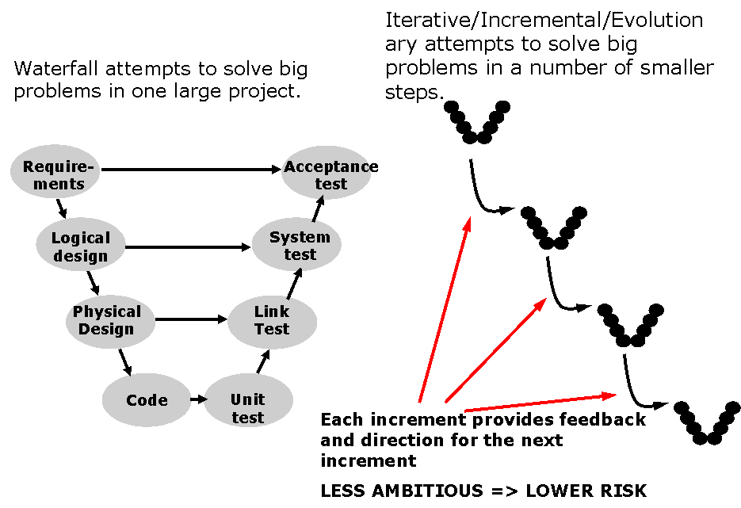
Iterative v Waterfall
Note: the creator of the Waterfall model, Winston Royce (1970) actually permitted and encouraged iterative development but this is not generally recognised.

Slide 10
Testing within a lifecycle model

Slide 11
Testing within a life cycle model
We 'divide and conquer' the task of testing
Testers should be involved in reviewing documents as soon as drafts are available in the development life cycle
Testing builds up as we progress through the various stages.
What happens at each stage? How do we determine the objectives for each level?

Slide 12
Typical test process?
Acceptance
Test
System
Test
Integration
Test
Component
Test
Ad hoc
Testing

Slide 13
From theory to the V-Model
Although variants of the V-model (verification and validation) exist four levels are common
The four commonly levels are:
component (unit) testing
integration testing
system testing
acceptance testing
V-model may have more, fewer or different levels of development and testing, depending on the project and the software product.

Slide 14
V model: waterfall and locks
Requirements
User
Acceptance
Test
Functional
Specification
System
Test
Physical
Design
Integration
Test
Program
Specification
Unit
Test

Slide 15
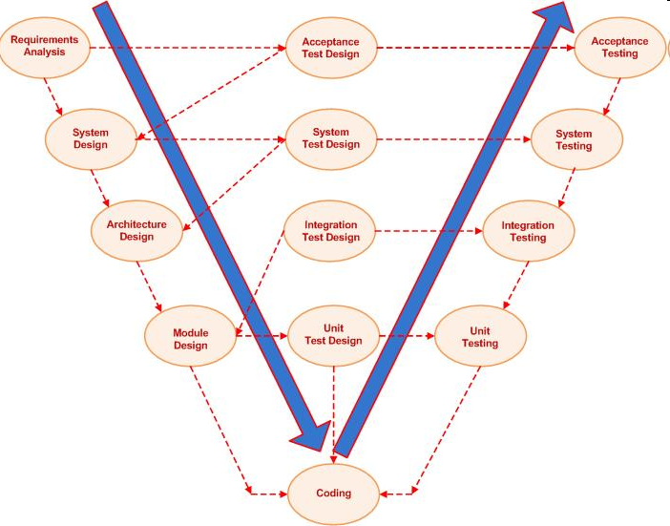
V Model
V-Model is commonly used in safety-critical software development.

Slide 16
Continuous Software Engineering

Slide 17
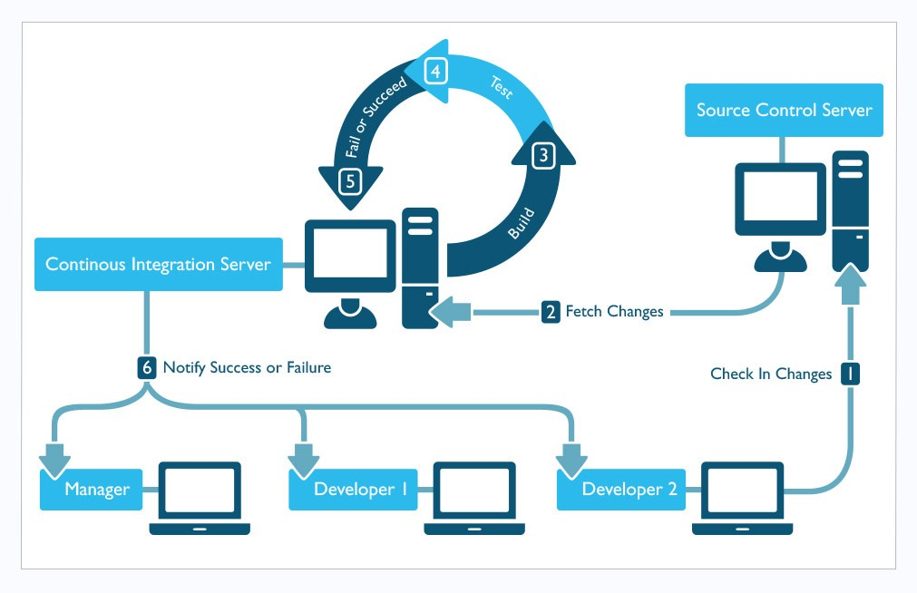
Continuous Software Engineering (CSE)
Source: https://insights.sei.cmu.edu/devops/2015/01/continuous-integration-in-devops-1.html

Slide 18
Continuous Software Engineering -Tooling
Examples of Tooling Used in CSE
Phase | Tool
Development | Fuge - http://fuge.io/
 | Seneca - http://senecajs.org/
 | HAPI - http://hapijs.com/
Repository | Git / github - https://github.com/
 | BitBucket - https://bitbucket.org/
Build | Jenkins - https://jenkins.io/
 | Drone - https://drone.io/
Test | Tap - https://testanything.org/
 | Phantom - http://phantomjs.org/
 | Pdiffy - https://github.com/kennychua/pdiffy
Infrastructure | EC2 - https://aws.amazon.com/ec2/
 | ELB - https://aws.amazon.com/elasticloadbalancing/
 | Consul - https://www.consul.io/
Deployment | Docker registry- https://docs.docker.com/registry/
 | Code Deploy – https://aws.amazon.com/codedeploy/
 | Swarm - https://docs.docker.com/swarm/
 | Kubernetes - http://kubernetes.io/
Source: O’Connor, R.V., Elger, P., Clarke, P. Continuous Software Engineering – A Microservices Architecture Perspective. To Appear In: Journal of Software Evolution and Process (2017)

Slide 19
Continuous Software Engineering - Continued
Automation/Tooling does not replace existing lifecycles.
Sometimes it is integrated into a traditional lifecycle model – e.g. using Continuous Integration in a V model
Traditional models continue to have an impact but take advantage of tooling where beneficial
Some software engineering has speeded up considerably because of the speed of computer based testing (e.g. DevOps and CSE).
And the tooling is not just related to testing. There is tooling support for many (all?) lifecycle phases.

Slide 20
Influences on the test process
The nature and type of faults to test for
The object under test
Capabilities of developers, testers, users
Availability of: environment, tools, data
The different purpose(s) of testing
to detect faults
to demonstrate contractual requirements are met
to provide evidence that software works and build confidence.

Slide 21
Lifecycle Model Influences Testing
The approach to testing can vary significantly between different lifecycle models
For example, in a traditional V model of software development: requirements are extensively elaborated for entire systems up front, these requirements are exhaustively tested prior to coding. The testing emphasis thereafter may focus on robust integration and system level testing.
In contrast, in a continuous software engineering approach: software requirements are not exhaustively elaborated for entire systems prior to coding and therefore, the capacity to test the system requirements as a whole up front does not exist. System testing still occurs, but in this scenario a robust focus on unit testing, integration testing and regression testing is emphasized.
Consider the difference between embedded software for a pacemaker (V Model) and a web site that is continually being evolved and extended (CSE). These two scenarios lend themselves to two different software development approaches and consequently, to two different testing strategies.

Slide 22
Not a “black and white” picture?
Aspects of testing that are common in CSE might be useful for traditional V model lifecycles.

Slide 23
Staged testing moves from small to large
We start by testing each component (in isolation)
As tested components become available, we test groups of programs - sub-systems
Then we combine sub-systems and test the system
Then we combine single systems with other systems and test.

Slide 24
Levels of testing have different objectives
The objectives at each level are different
Individual components are tested for their conformance to their specification
Groups of components are tested for conformance to the physical design
Sub-systems / systems are tested for conformance to the functional specifications and requirements.

